Slide 1


Webmarkup
Lecture 1
[3 EC, 84 SBU , Product]
Location : Haarlem
lecture manager : Micha van der Meer
Version 4.12
Notes:
Company logo are respective owned by the companies
Photo’s used are royalty free and under (CC0) license pixels.com
All other not mentioned graphics or text are © Witan BV
Questions ? Lecture material owner Micha van der Meer

Slide 2


Agenda
Introduction and background teacher.
What to expect from this course
Eur 32.400
Webmarkup is logic
Notepad ++
Web browsers
Github
SAAS, PAAS & NAS
Filezilla
Resources on internet
2
Notes:
(CC0) license

Slide 3
Course planning
Term 1 |  | Week
Lecture 1 | Introduction, Webmarkup setup | 36
Lecture 2 | Basic HTML | 37
Lecture 3 | Advanced HTML | 38
Lecture 4 | Basic CSS | 39
Lecture 5 | Advanced CSS | 40
Lecture 6 | Expert CSS + provision and explaining (end)assessment | 41
Lecture 7 | Webmarkup development tools | 43
Exam weeks | Finishing assessment | 44
11 November 2022 | Deadline assessment | 45
3

Slide 4
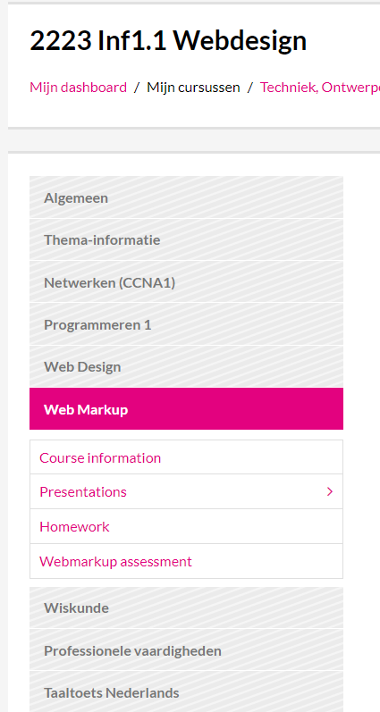
Webmarkup @ https://moodle.inholland.nl/course
[IT] IT1.1 Web Design or [INF] Inf1.1S Webdesign
4

Slide 5

Quiz
5 min
HTML 5 or not? | Right | Wrong
I. <p>ipsum muspi lupsum wuppie</p>
II. If a < 10
III. <br />
IV. ASP.NET
V. \n
VI. Error 37
VII. font-family: "Times New Roman";
5
Notes:
Yes, 100% HTML5. Maybe the design department is not happy with the ipsum text, but nothing wrong with the code.
No, not standard HTML but.. If are possible like -> <% if (GlobalVariable == "2") %> or other example <!--[if !IE]><!--> code here <!--<![endif]-->
Yes, it is legal tag, but never us it! Solve it with CSS.
Yes, as text “ASP.NET”… But ASP.NET as ASP.NET extends the .NET platform with tools and libraries specifically for building web apps. It is not HTML5.
No, The /n stands for "new line", again, from typewriter days you moved down to a new line. Not nessecarily to the start of it though, which is why some OSes adopted the need for both a /r return followed by a /n newline, as that was the order a typewriter did it in. It also explains the old 8bit computers that used to have "Return" rather than "Enter", from "carriage return", which was familiar.
No, no, no,..O no, Know your game history! Error 37 is a meme originating from Diablo III's release on 15 May 2012. The origin of the meme derives from an error message faced by most players when trying to login to the game. The error was caused by the overload of the battle.net login servers. The error message reads "The Servers are Busy at this time. Please try again later. (Error 37)“. Error codes like 400 Bad Request, 403 Forbidden, 404 Not Found are Hypertext Transfer Protocol (HTTP) error and do not have anything to-do with HTML5.
No, it is CCS.. What is CCS?? With 3 weeks you will know (cliffhanger :P )

Slide 6

Homework?
6
Notes:
Foto (CC0) license

Slide 7
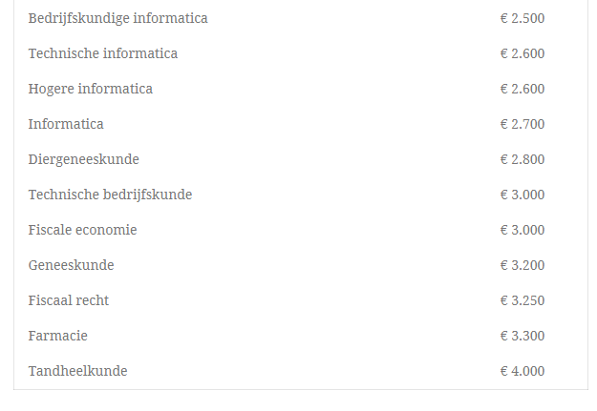
Bachelor
Start
Salary
2022
IT
EUR 32.400 P/Y
7
Notes:
Why should you do your homework?
Fact : 70% of the people who do not do their homework fail for Webmarkup.
Every year you do not repeat you could work for money.
https://www.gemiddeld-inkomen.nl/startsalaris-hbo-wo/
But what should you do with Eur 32.000 extra??
On the other side,… every year you repeat a year the teachers having salary and a full class!

Slide 8

Structure of the lectures
Rehearsal and questions sent by e-mail
Quiz
Lecture on theory and answering questions on theory.
Making individual mini cases / assignments
Summary of the lecture
Sneak peek next week
Questions lecture
Making the assignment for next week (homework)
8

Slide 9

Programming = logical thinking
1 | = |  |  | 6 | =
2 | = |  |  | 7 | =
3 | = |  |  | 8 | =
4 | = |  |  | 9 | =
5 | =
10 SEC
9
Notes:
10 sec to remember the shapes numbered from 1 till 9
Bugfix: Thanks,.. Stefan de Jong!

Slide 10
Programming = logical thinking
9 2 7 3 8 1
10
Notes:
10 sec to remember the shapes numbered from 1 till 9

Slide 11
Programming = logical thinking
1 | 2 | 3
4 | 5 | 6
7 | 8 | 9
11
Notes:
10 sec to remember the shapes numbered from 1 till 9

Slide 12

What is “Webmarkup” ?
[HTML]
HTML (HyperText Markup Language) is the language in which you structure the webpage
HTML divides documents in parts/sections
[CSS]
Colours
Margins
Positioning
Style
[Tools]
Development tools & code libraries
JavaScript | jQuery | AJAX (is out of scope!)
12
Notes:
Scope

Slide 13







Software and Tools
We recommend to use Notepad++, but feel free to use an alternative like Brackets, etc.
We are not giving support on the alternatives!
Alternatives
https://notepad-plus-plus.org/download
13
13
Notes:
Company and product logo’s are respective owned by the companies

Slide 14


Notepad ++
https://notepad-plus-plus.org/download
14
14
Notes:
Company and product logo’s are respective owned by the companies

Slide 15
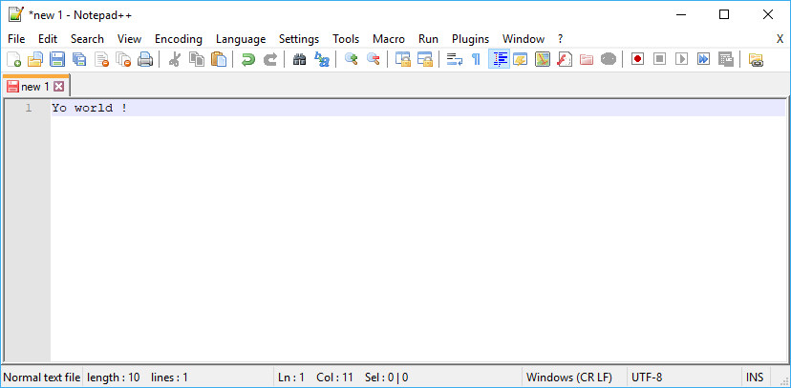
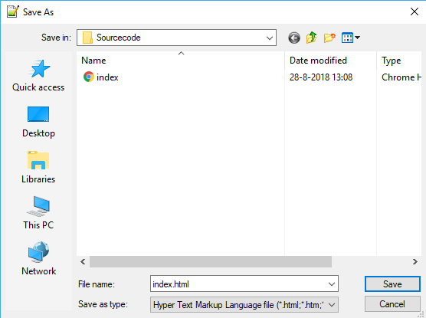
Our first webpage
The first page of a website is
always called index.html
15

Slide 16

Drag and drop your file on any internet browser
16
Notes:
Company logo’s are respective owned by the companies

Slide 17
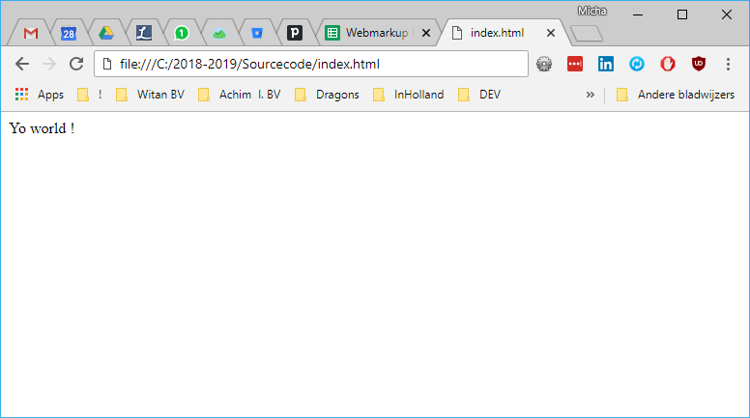

Result : our first webpage
17
Notes:
Yeah - Royalty free (CC0) license

Slide 18

Assignment lecture 1.1
15 min
Download and install “Notepad ++” on a computer.
Create a file with “File” -> “New”
Write a nice text for your first webpage
Save this file with “File” -> “Save as” on your “desktop” as “index.html”
Drag and drop the file to any web browser.
18
Notes:
Royalty free (CC0) license
Teacher guide : Min 30 – 40 (from 90 min)

Slide 19


Power failure?
?
19
Notes:
©Rodolfo Clix (copyright free)

Slide 20

Protect your source code
What are Source code management programs?
Why do I need backups?
Why do I need a history?
Work with other people?
Beware of plagiarism !
20

Slide 21




Source code management & back-ups
Be sure to frequently back-up your code!
For sharing your source code with others and working in teams, we recommend using a source code management tool.
21

Slide 22

Source code management & back-ups
22
Notes:
No source code no graduation!
Royalty free (CC0) license

Slide 23
GitHub
We recommend to use GitHub but feel free to use an alternative.
We are not giving support on the alternatives! ot giving support on the alternatives!
23

Slide 24
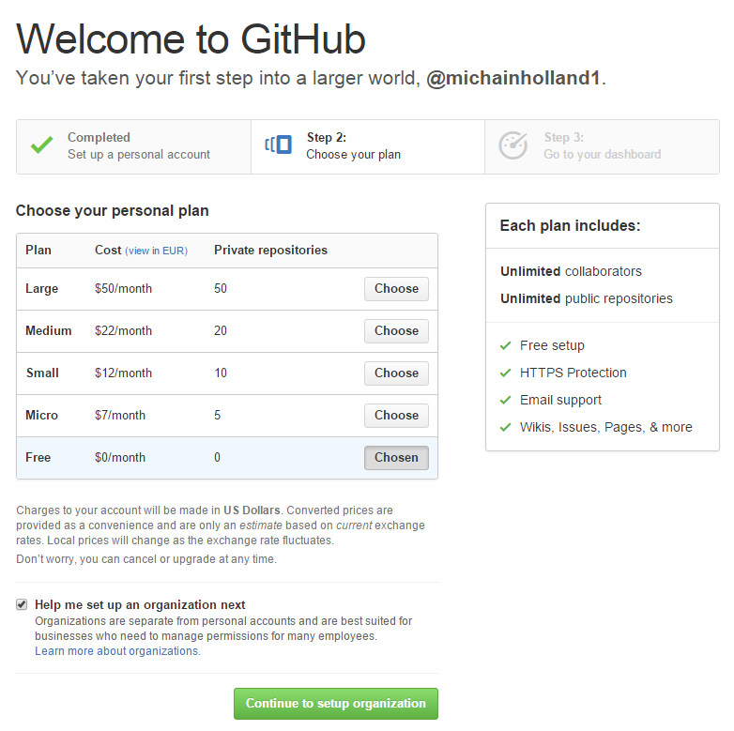
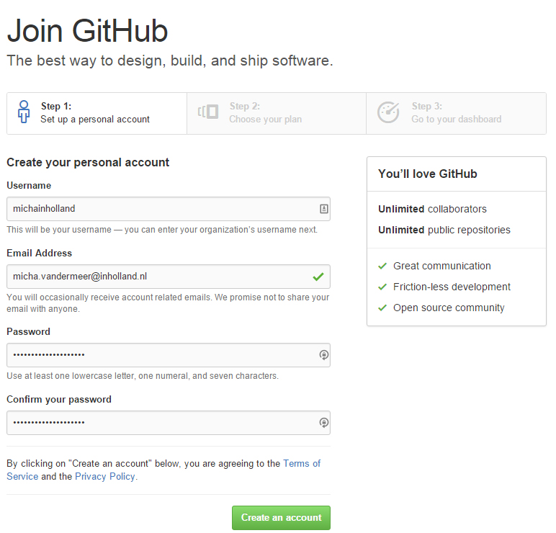
GitHub | Create personal account
https://github.com/
24

Slide 25
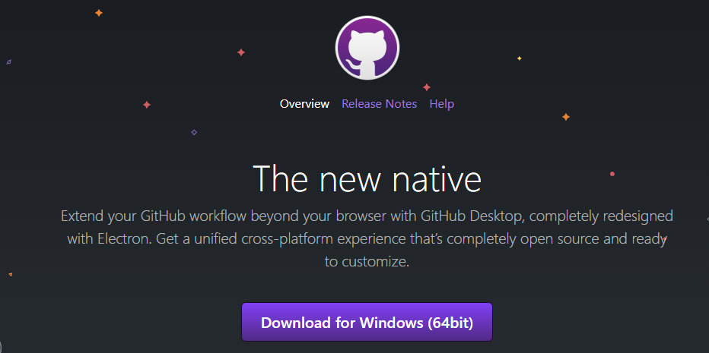
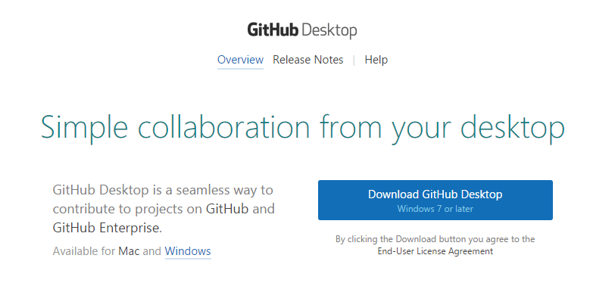
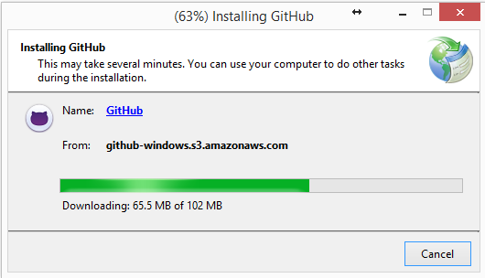
GitHub | Install local on your desktop
https://desktop.github.com/
25

Slide 26
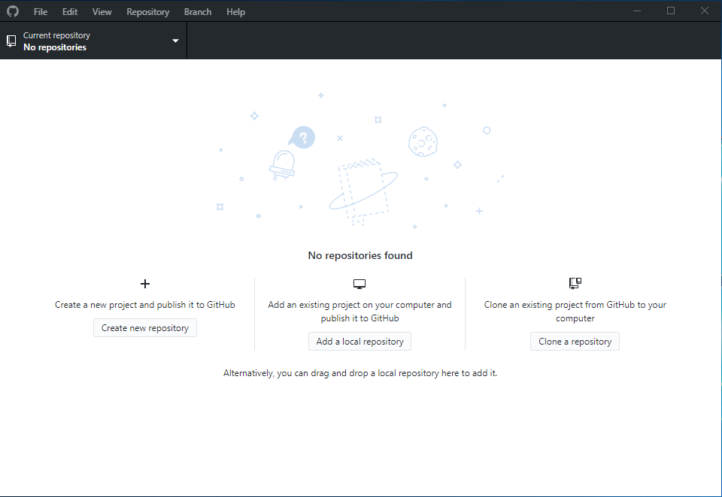
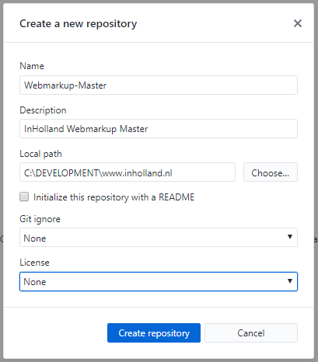
GitHub | Local
26

Slide 27
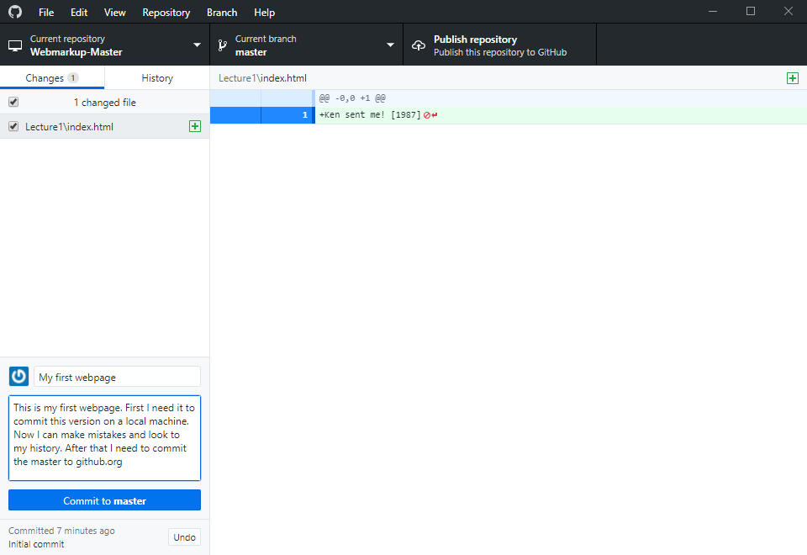
GitHub | Local – Commit to LOCAL master
27
Notes:
Do not forget to copy your index.html now into your local repository. On my machine it was on C:\DEVELOPMENT\www.inholland.nl. This will not work on the inholland PC! Use your home folder -> H:\folderX

Slide 28
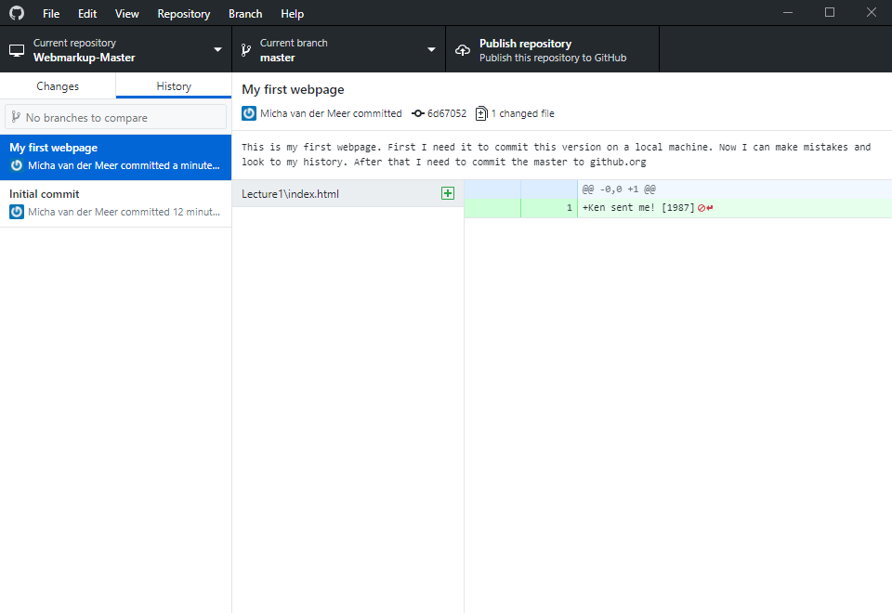
GitHub | Local – Check your LOCAL work
28
Notes:
Local submission

Slide 29
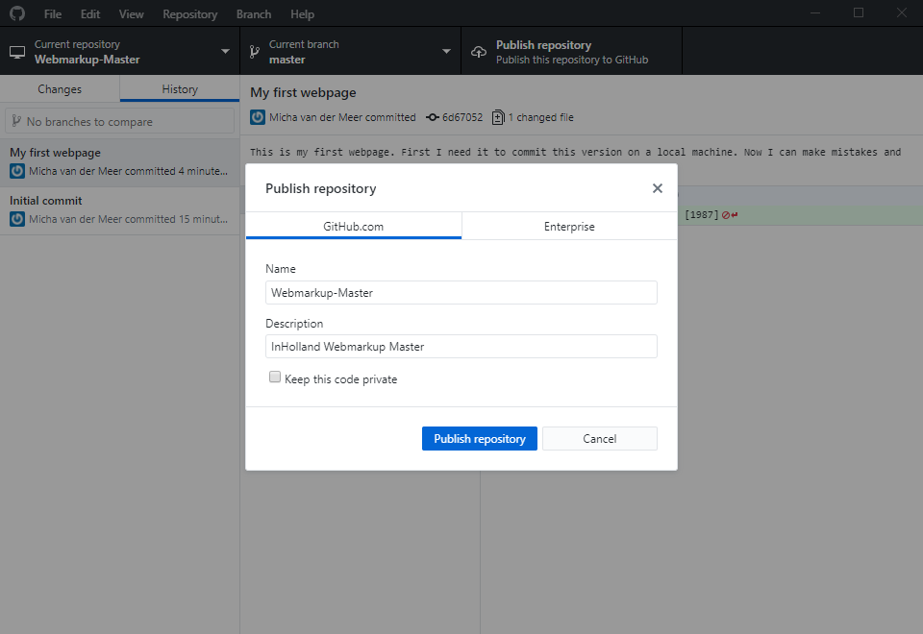
GitHub | Submit your changes ONLINE on github.org
29
Notes:
Online submission

Slide 30
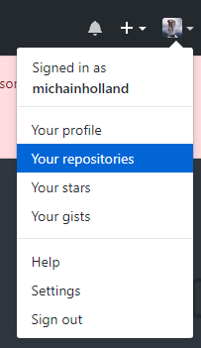
GitHub – Online @ github.com
https://github.com/
30
Notes:
See if everything went well.

Slide 31
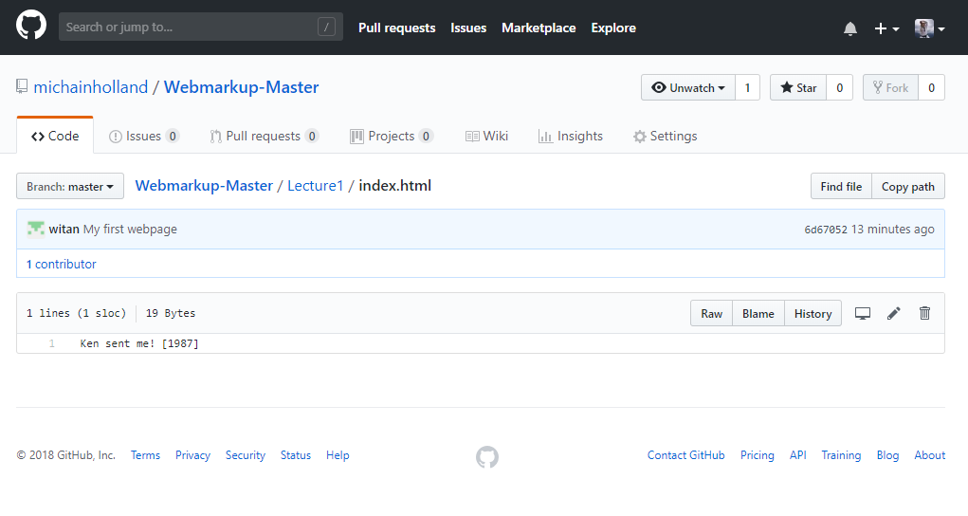
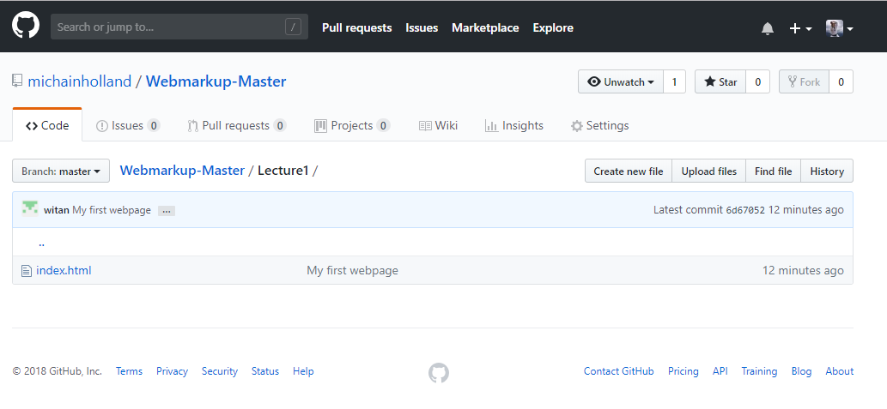
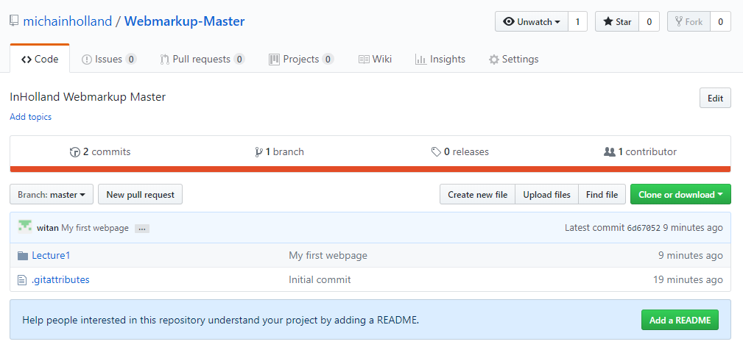
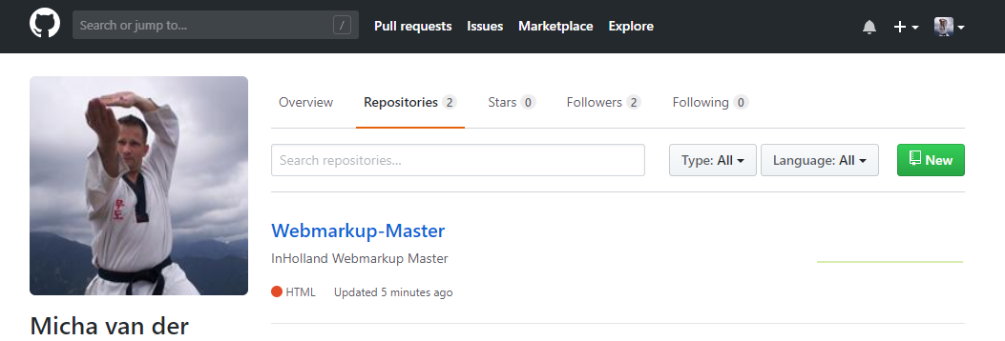
GitHub – Online @ github.org
31
Notes:
See if everything went well.

Slide 32
Assignment lecture 1.2
25 min
Download and install GitHub on a computer
Commit your source code on a local machine
Sync your source code on GitHub online
Find out what a “branch” is and create one
Find out why should “clone” and create one
Find out what the difference is between Push. Pull, Merge, Fetch and Checkout.
Find out how to work with the command line and do the same as above.
Make a branch from your project . Invite another student to work on your branch. Make both changes to a file called “conflict.html”. Commit the changes to the online repository. Try to fix the conflict.
32
Notes:
Royalty free (CC0) license
Teacher guide : Min 50 – 60 (from 135 min)

Slide 33

Conquer the world with you website
33
Notes:
How to reach the world?
Picture world : CC0 License

Slide 34

ISP [Internet Service Providers]
34
Notes:
Picture : ISP CC0 License

Slide 35
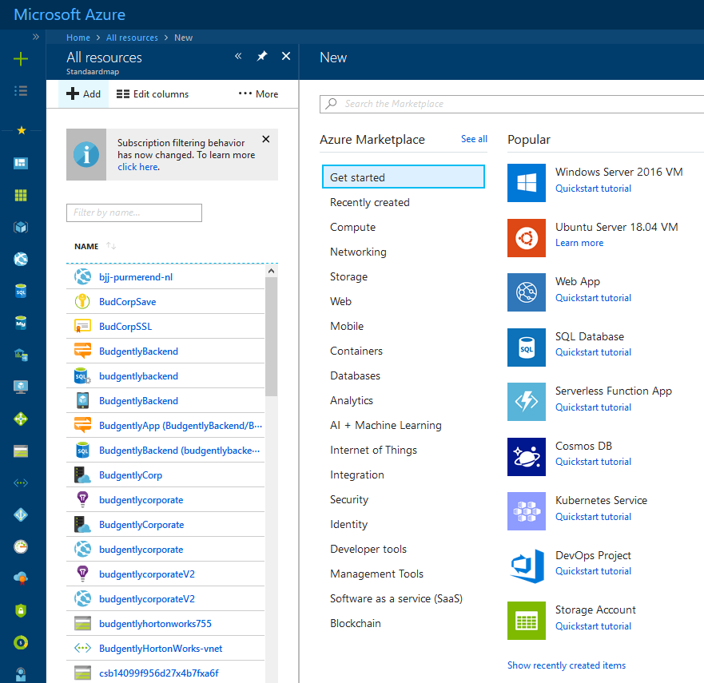


PAAS [Platform Architecture As Service]
35

Slide 36
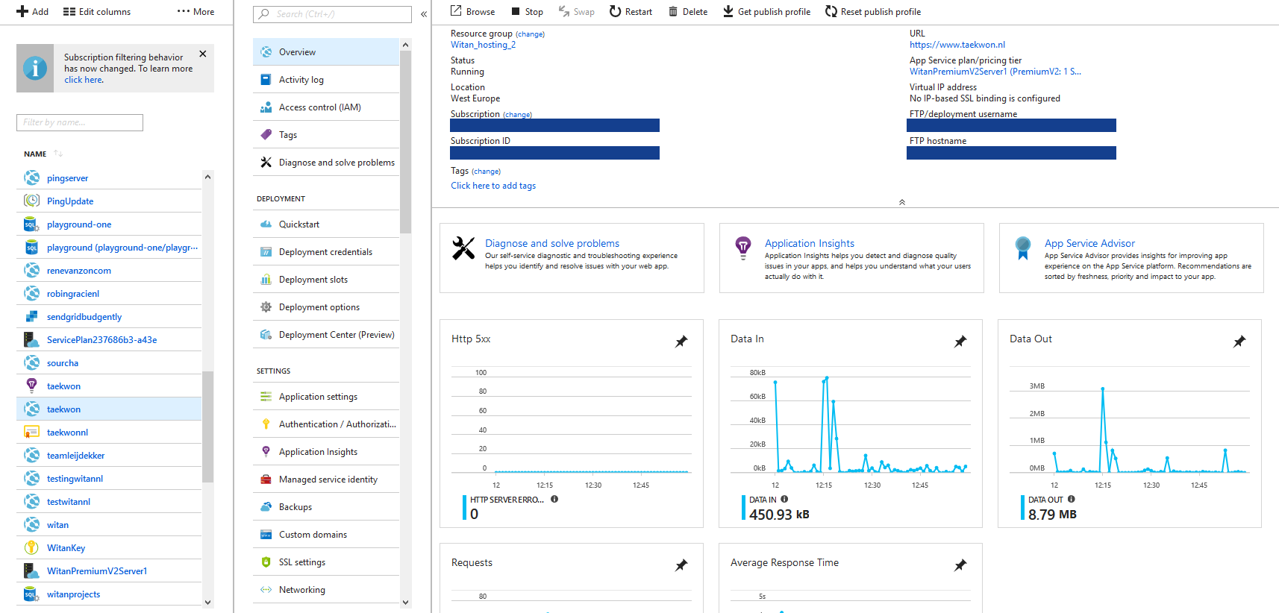
PAAS [Platform Architecture As Service] – control panel
36

Slide 37


IAAS [Infrastructure Architecture As Service]
37

Slide 38
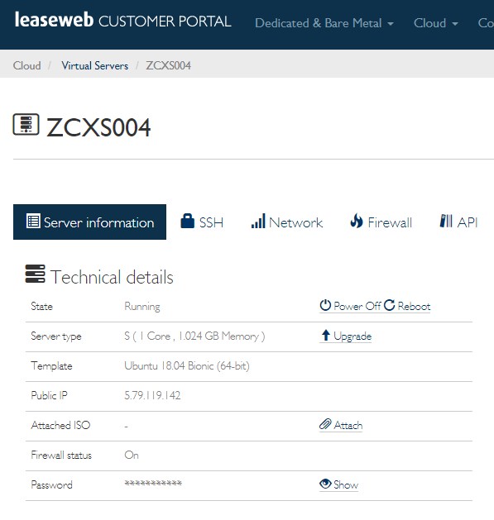
IAAS [Infrastructure Architecture As Service]
38

Slide 39



NAS [Network Attached Storage]
39

Slide 40
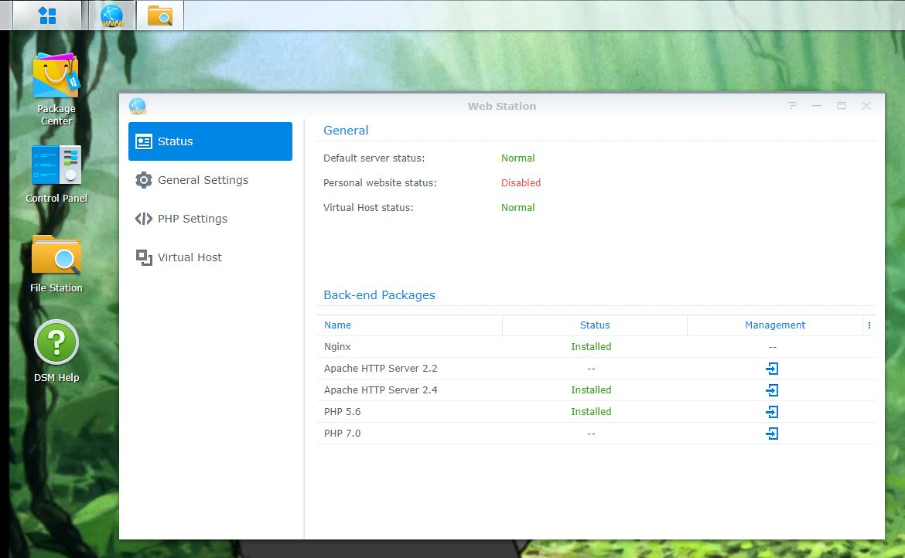
NAS [Network Attached Storage]
40

Slide 41
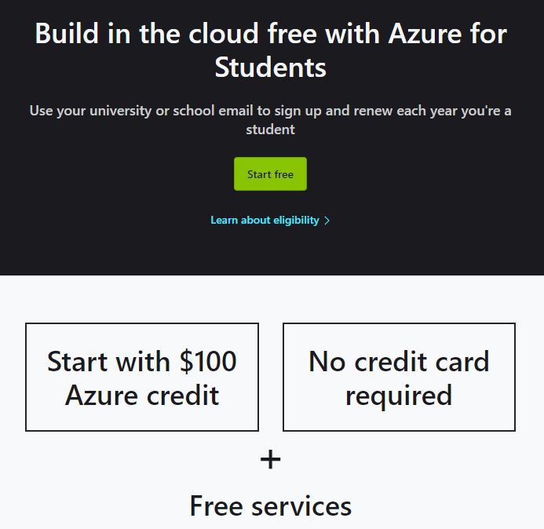
$100 credit @ Microsoft Azure without a credit card!
https://azure.microsoft.com/en-us/free/students/
41

Slide 42
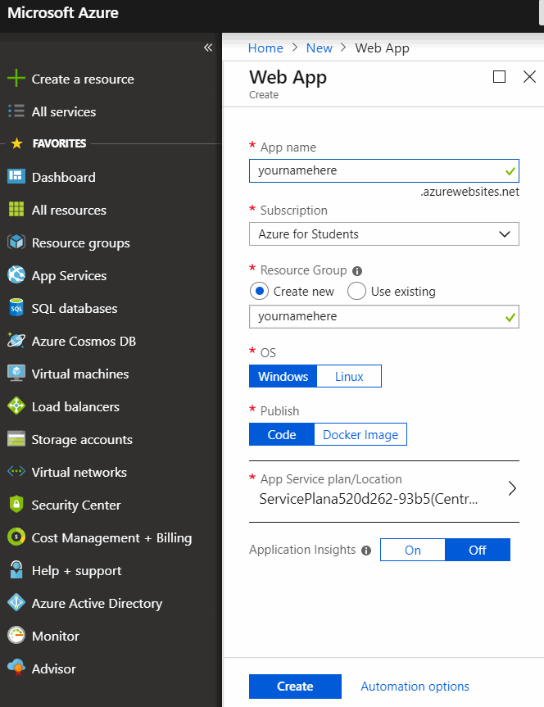
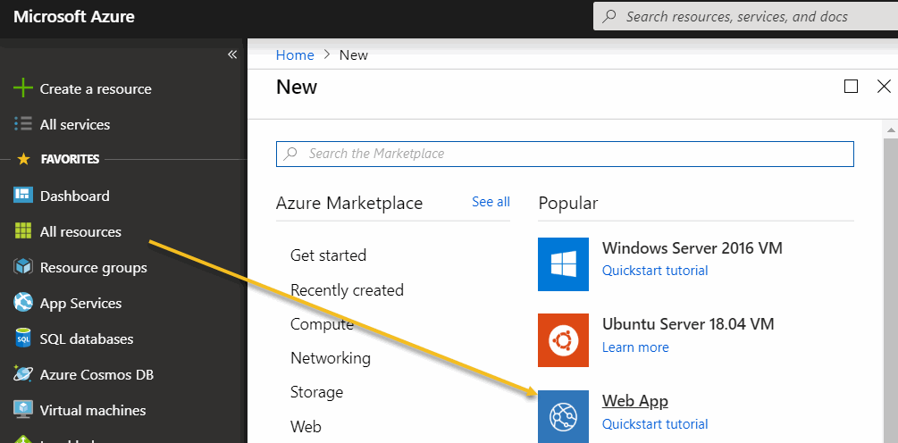
$100 credit @ Microsoft Azure without a credit card!
https://www.microsoftazuresponsorships.com/Usage
42

Slide 43
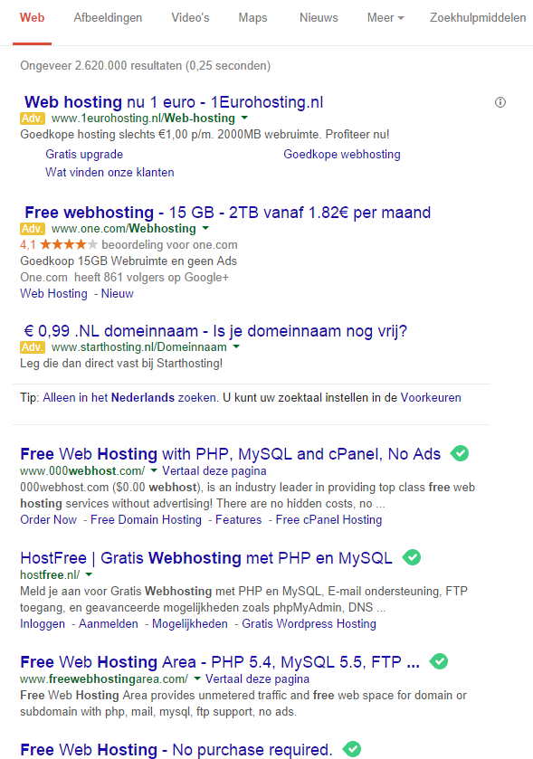
FREE! Webhosting
Show me
$$$$
43

Slide 44
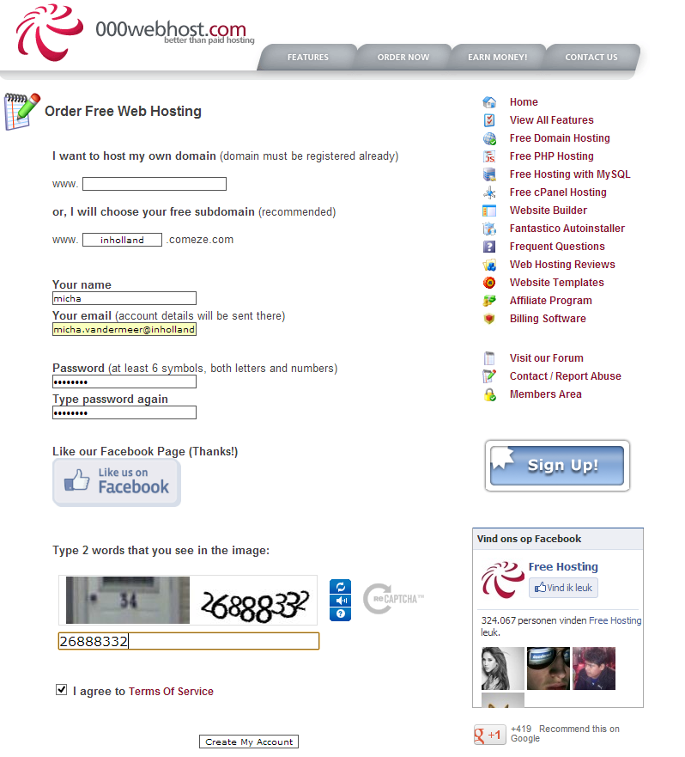
FREE! webhosting
☹
44

Slide 45
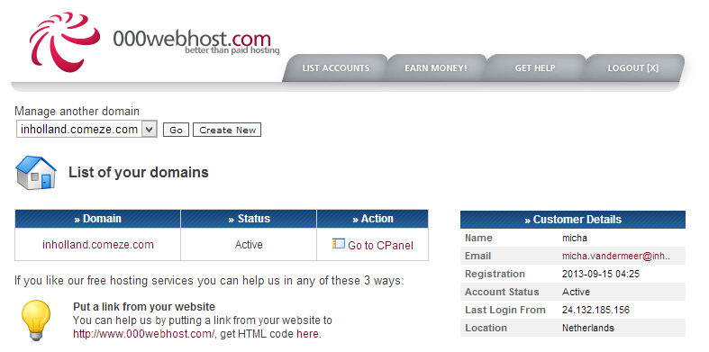
FREE! webhosting
45

Slide 46
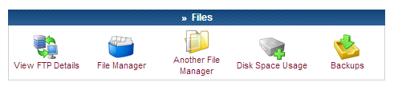
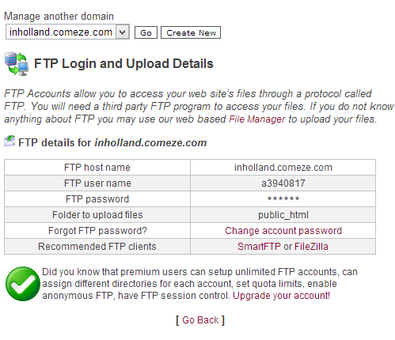
FREE! webhosting
46

Slide 47
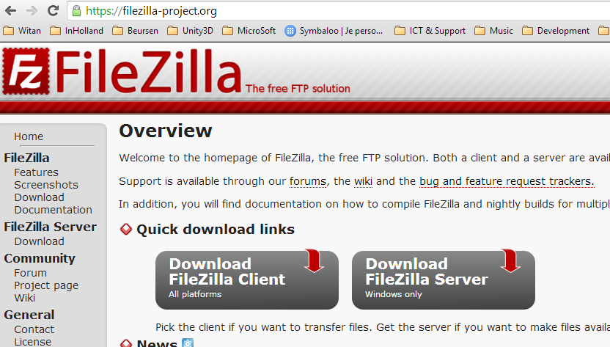
FTP [File Transfer Protocol]
47

Slide 48
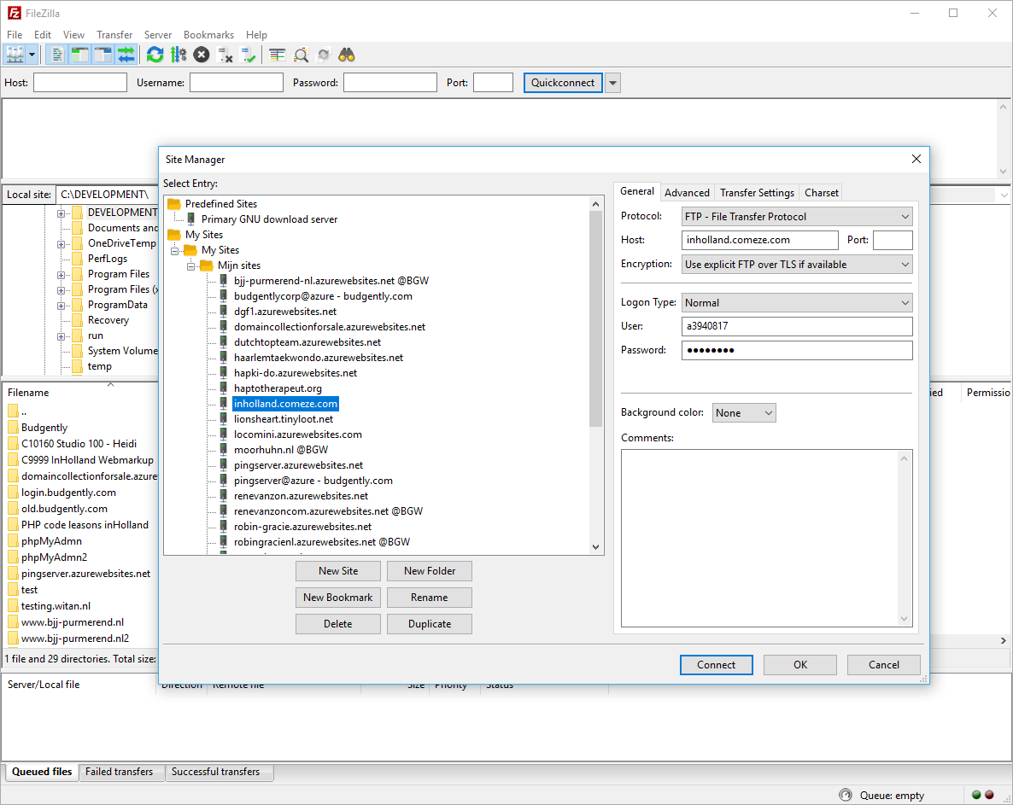
FTP [File Transfer Protocol]
48

Slide 49
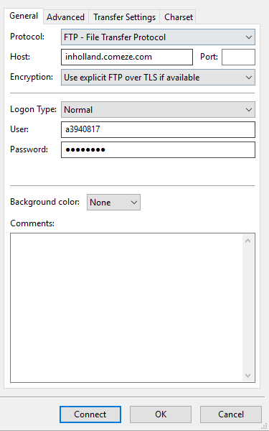
FTP [File Transfer Protocol]
49

Slide 50
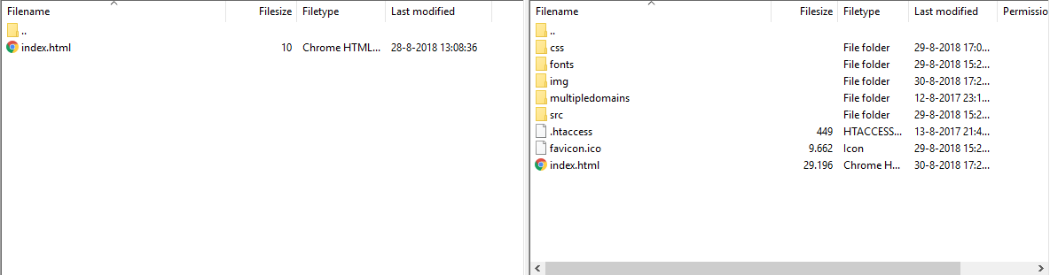
FTP [File Transfer Protocol]
50
Notes:
Questions?

Slide 51
Assignment lecture 1.3
Download and install Filezilla on your computer
Create an account at 000webhost.com or other provider
Upload “index.html” with the text “hello world”
Access the URL to find out if your webpage is working
Download “index.html” from the webserver to a sub-folder called “\test”
Find out what the problem is with 000webhost.com (O,o,..It looks that your page has changed after the page is uploaded)
Try to automate Notepad++ with the FTP (NppFTP) pluging
25 min
51
Notes:
Royalty free (CC0) license
Teacher guide : Min 80 – 100 (from 135 min)

Slide 52
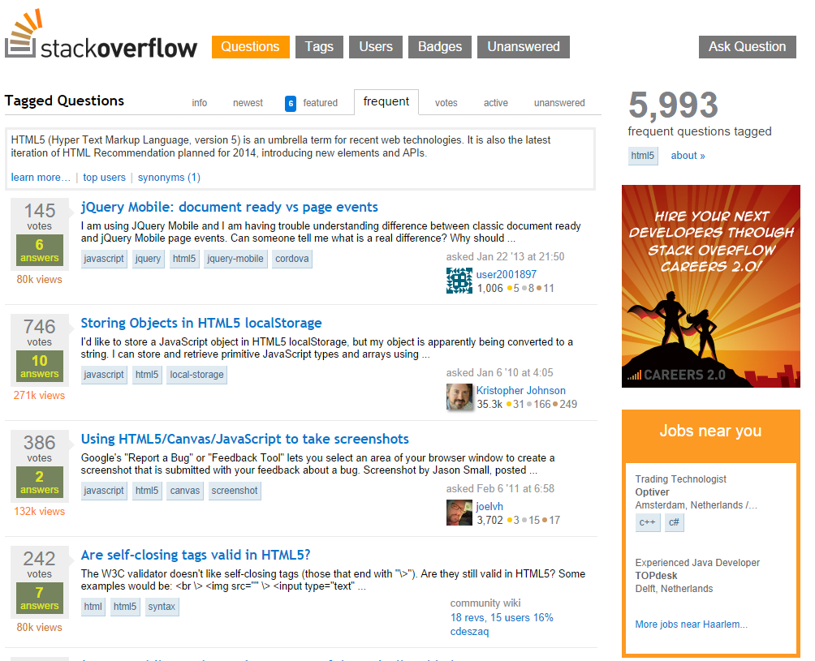
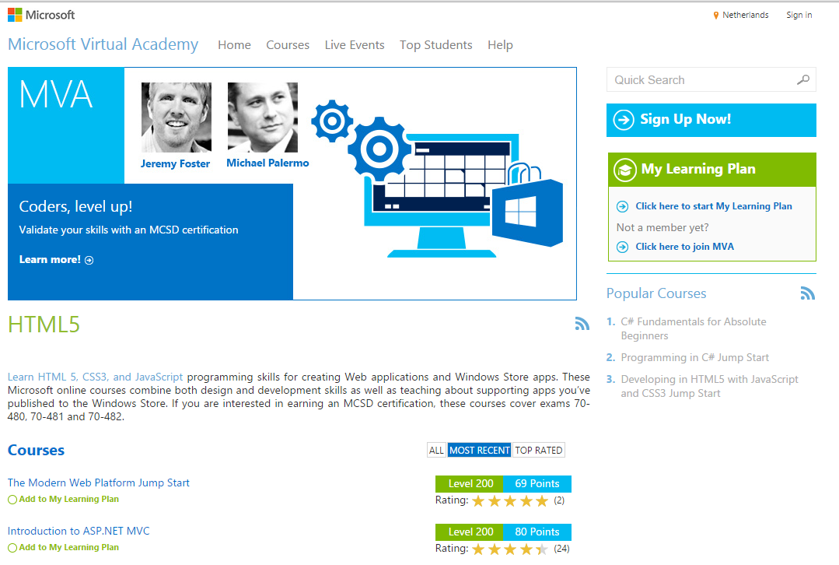
Resources on internet
http://stackoverflow.com/ [Forum]
http://www.microsoftvirtualacademy.com/ [Tutorials + Certification] http://www.w3schools.com/ [Tutorials & Reverence guide]
52
Notes:
Questions?

Slide 53
Resume lecture
Eur 32.400
Webmarkup is logic
Notepad ++
Web browsers
Github
SAAS, PAAS & NAS
Filezilla
Resources on internet
53
Notes:
(CC0) license

Slide 54

Next week…
HTML Markup
HTML Bots vs Users
HTML Basics
headings
paragraph
forbidden html
anchor
files and folders
images
ordered vs unordered lists
block vs inline elements
tables
54
Notes:
(CC0) license

Slide 55

Questions
55
Notes:
(CC0) license

Slide 56
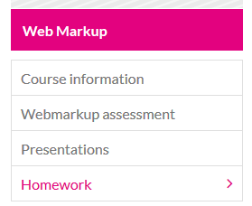
Homework for next lecture
56

